Slide 1
Marketing and Retail Analytics: Capstone Project

Slide 2
Content:
Background on project
Objectives
Task-1: Preparation of Data
Task-2:Creation of Tableau Dashboard
Dashboard Snapshots and insights
Market Basket Analysis
Inferences
Recommendations

Slide 3
BACKGROUND:
OList is an e-commerce company that has faced some losses recently and they want to manage their inventory very well so as to reduce any unnecessary costs that they might be bearing.
need to manage the inventory cost of this e-commerce company.
need to identify top products that contribute to the revenue and also use market basket to analyse the purchase behaviour of individual customers to estimate with relative certainty
What items are more likely to be purchased individually or in combination with some other products.
need to help OList to identify the product categories which they can get rid of without significantly impacting business

Slide 4
OBJECTIVES:
TASK-1 PYTHON NOTEBOOK
Missing values are correctly identified and treated accordingly, i.e., no missing value is present in the dataset.
Duplicates are correctly identified and removed from the dataset, i.e., no duplicates are present in the dataset.
The records are filtered to include only orders with order status as ‘delivered’.
The required tables are identified and joined in the correct way during data import.
TASK-2 TABLEAU
The top 20 ordered products by quantity are identified and visualized.
The percentage running totals by revenue and number of orders to be depicted correctly for each product.
The product categories which are ordered more than 5 times to be identified.
Combinations of product categories which are frequently ordered together are identified and visualised appropriately

Slide 5
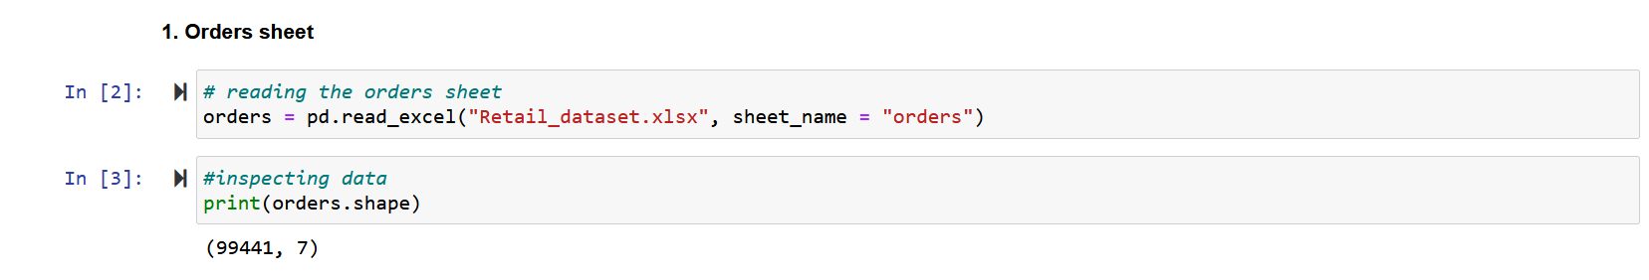
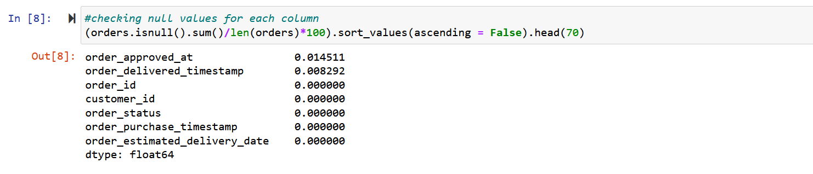
TASK-1 PREPARING DATA USING PYTHON
Read Data for each sheet provided in Excel sheet Retail_dataset
Check Null values for each sheet provided in Excel sheet Retail_dataset

Slide 6
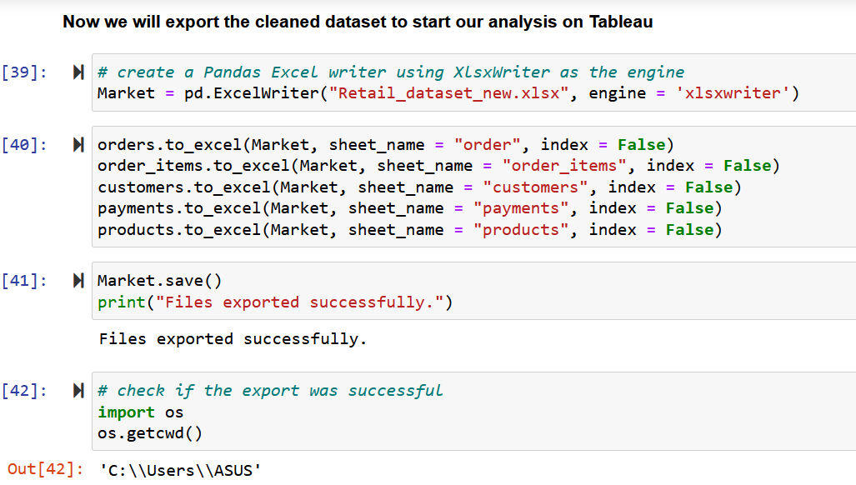
TASK-1 PREPARING DATA CONTD….
Now we will export the cleaned dataset to start our analysis on Tableau
A new dataset consisting of order id and product category name was created for Market Basket Analysis.

Slide 7
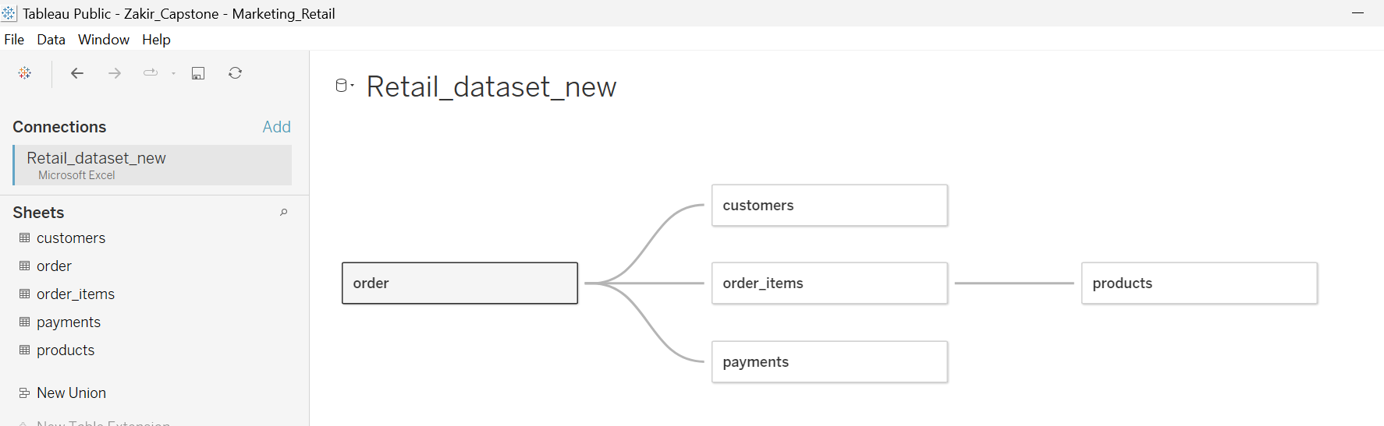
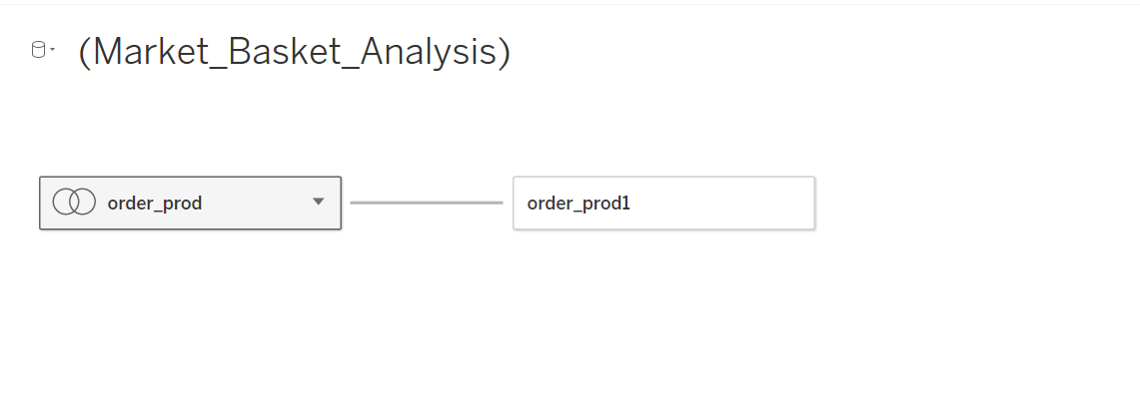
TASK-2 PREPARING TABLEAU DASHBOARD
Form the connection between tables through clean retail dataset and marketing basket excel sheet details extracted using python notebook

Slide 8
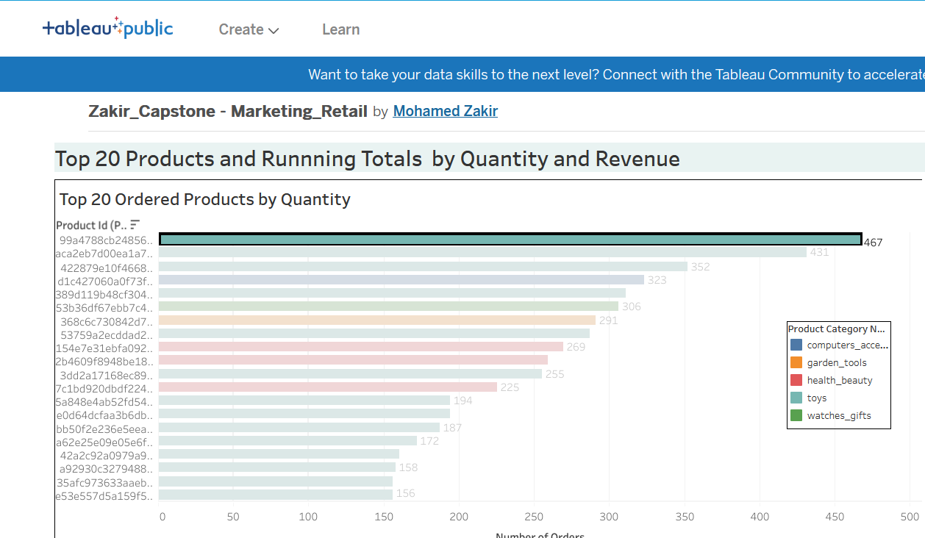
The top 20 ordered products by quantity are identified and visualized.
The highest ordered product is from the Toys category and has been ordered 467 times.
From Dashboard we can infer that Toys are ordered more under top 20 as green highlights more

Slide 9
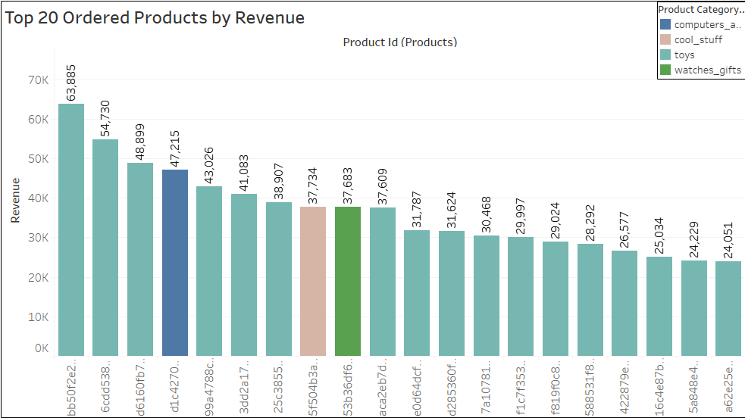
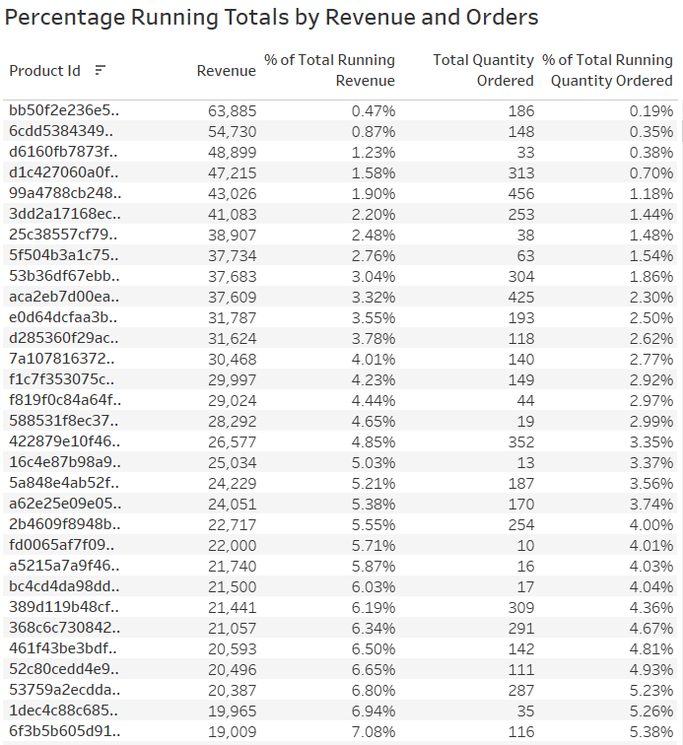
The highest revenue generation is 63, 885 which belongs to the Toys Category.
The Percentage of Total Running Revenue and Quantity Ordered has been broken down by Product Id.

Slide 10
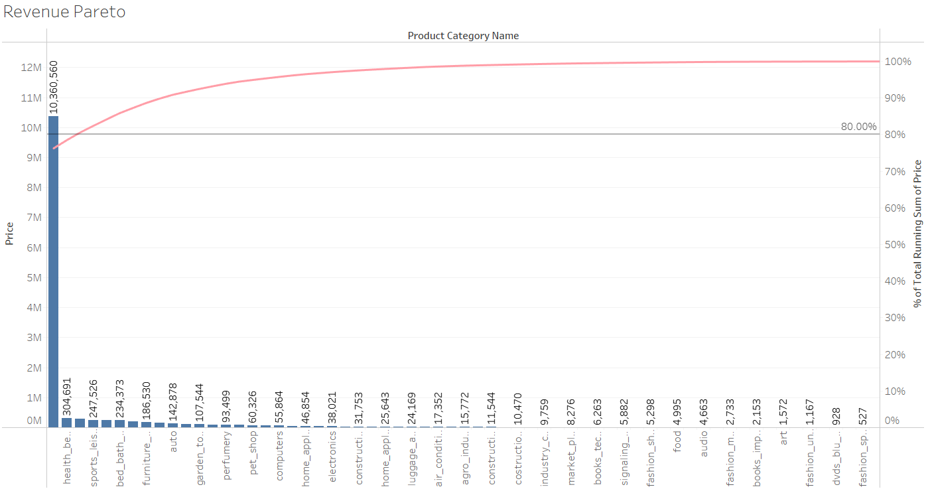
Revenue pareto analysis is performed to understand ideal category depth for each category.
Toys, health_beauty and watches_gift combine generate 80.56% of the revenue.
Toys alone generates 76.23% of the revenue.
The rest of the 70+ product categories generates 19.44% of the revenue.

Slide 11
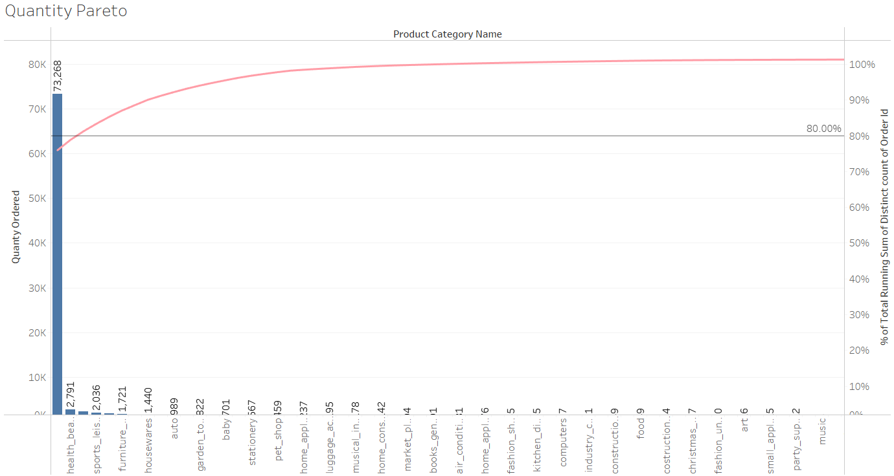
Toys, health_beauty and bed_bath_table make up 80.38% of the total orders.
Toys alone has 75.94% of the total orders.
The rest of the 70+ product categories generate 19.62% of the total orders.

Slide 12
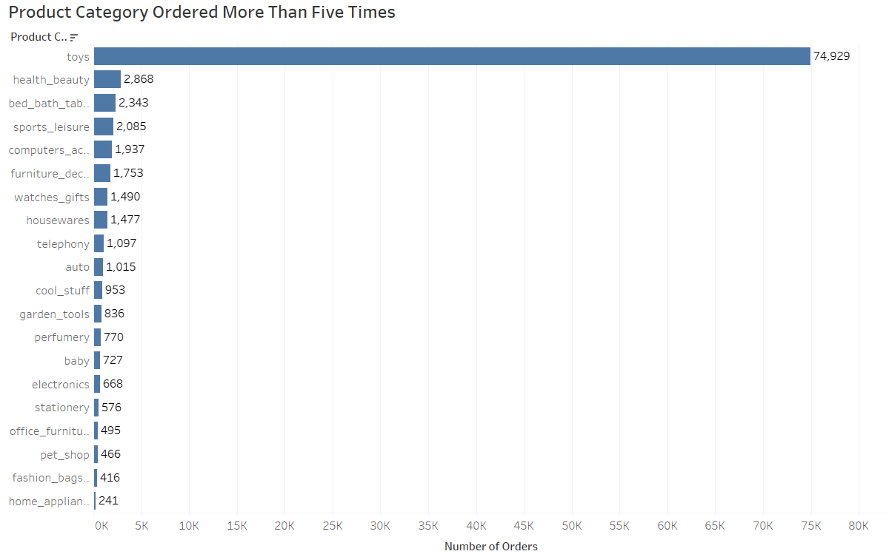
The product categories which are ordered more than 5 times to be identified.
Toys category is the most ordered category with a total of 74,929 orders.
Health_beauty, bed_bath_table and sports_leisure are the next most ordered category.

Slide 13
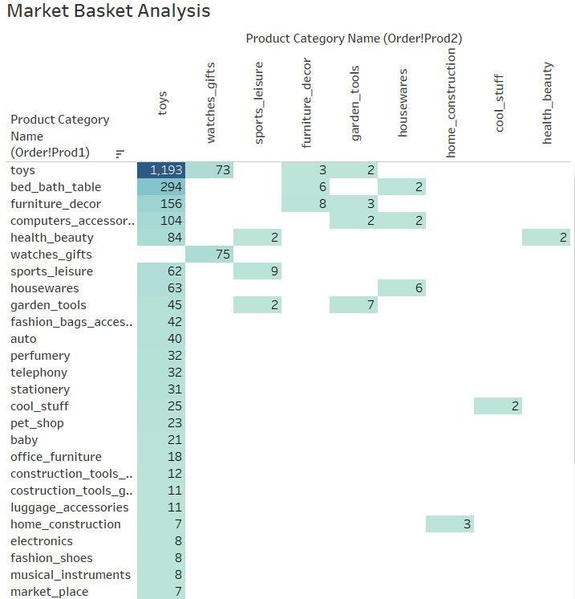
Market Basket Analysis
Market basket analysis is performed to identify the frequently ordered category association.
Toys are often purchased with various other categories as shown in this Market Basket Analysis.

Slide 14
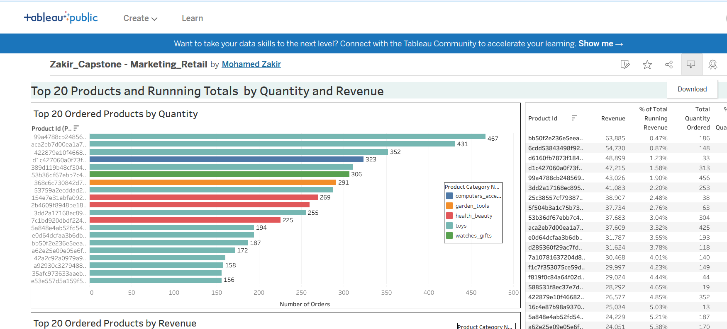
Save it online so data connection remains and work with easily
Download Dashboard file for submission

Slide 15
Inferences:
The category ‘toys’ is the most ordered category as it is ordered 74929 times (76% of the total number of orders)
Apart from ‘toys’, the categories ‘health_beauty’,’bed_bath_table’,’sports_leisure’, ‘computer_accessories’ and ‘furniture_decor’ are the most frequently ordered categories.The above categories with ‘toys’ or/and with each other are most frequent in customers’ basket.
It is observed that despite of the high price, some products are frequently purchased by the customers.
Only the cases having order status as ‘delivered’ are considered.
We assumed that the data provided was achieving the desired revenue.

Slide 16
Recommendations:
Target customers who have children to boost up sales as they are most likely to purchase ‘toys’ which is the most ordered category.
Offer Promo-codes or discounts on frequently ordered category associations and the most ordered products to attract more customers.
Consider the ideal category depth to minimize the inventory cost by getting rid of the products which are seldom ordered and/or do not have a significant contribution to the total revenue under each product category.

